Slide 1
Machine Learning
Chapter 07
Computational Learning Theory

Slide 2
INTRODUCTION
This theory seeks to answer questions such as
Under what conditions is successful learning possible and impossible?"
and "Under what conditions is a particular learning algorithm assured of learning successfully?
Two specific frameworks for analyzing learning algorithms are considered.
Probably approximately correct (PAC) framework and mistake bound framework

Slide 3
We will be concerned with questions such as how many training examples are sufficient to successfully learn the target function, and how many mistakes will the learner make before succeeding.
As we shall see, it is possible to set quantitative bounds on these measures, depending on attributes of the learning problem such as:
The size or complexity of the hypothesis space considered by the learner
The accuracy to which the target concept must be approximated
The probability that the learner will output a successful hypothesis
The manner in which training examples are presented to the learner

Slide 4
Our goal is to answer questions such as:
Sample complexity. How many training examples are needed for a learner to converge to a successful hypothesis?
Computational complexity. How much computational effort is needed for a learner to converge to a successful hypothesis?
Mistake bound. How many training examples will the learner misclassify before converging to a successful hypothesis?
We might specify that to succeed, the learner must output a hypothesis identical to the target concept

Slide 5
PROBABLY LEARNING AN APPROXIMATELY CORRECT HYPOTHESIS
probably approximately correct (PAC) learning model.
We begin by specifying the problem setting that defines the PAC learning model,
then consider the questions of how many training examples and how much computation are required in order to learn various classes of target functions within this PAC model.

Slide 6
The Problem Setting
let X refer to the set of all possible instances over which target functions may be defined.
For example, X might represent the set of all people, each described by the attributes age (e.g., young or old) and height (short or tall).
Let C refer to some set of target concepts that our learner called upon to learn
Each target concept c in C corresponds to some subset of X, or equivalently to some boolean-valued function c : X -> {0, 1).
For example, one target concept c in C might be the concept "people who are skiers.“
If x is a positive example of c, then we will write c(x) = 1; if x is a negative example, c(x) = 0.

Slide 7
We assume instances are generated at random from X according to some probability distribution D.
Training examples are generated by drawing an instance x at random according to D, then presenting x along with its target value, c(x), to the learner.
The learner L considers some set H of possible hypotheses when attempting to learn the target concept
After observing a sequence of training examples of the target concept c, L must output some hypothesis h from H, which is its estimate of c.
To be fair, we evaluate the success of L by the performance of h over new instances drawn randomly from X according to D, the same probability distribution used to generate the training data

Slide 8
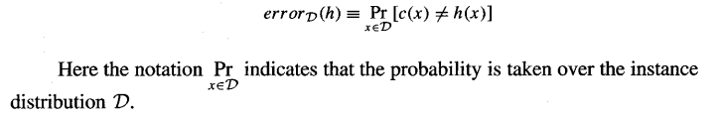
Error of a Hypothesis
we are interested in how closely the learner's output hypothesis h approximates the actual target concept c,
let us define the true error of a hypothesis h with respect to target concept c and instance distribution D.
Definition: The true error (denoted error_{D}(h)) of hypothesis h with respect to target concept c and distribution D is the probability that h will misclassify an instance drawn at random according to D.

Slide 9
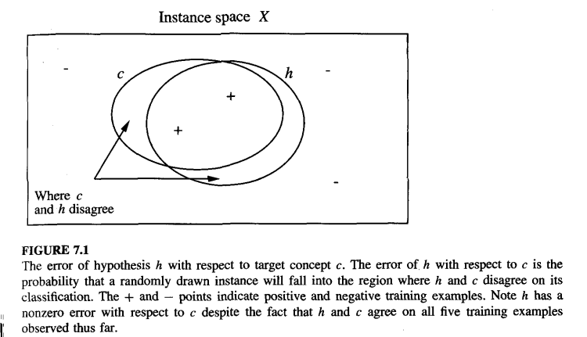

Slide 10
Figure 7.1 shows, The concepts c and h are depicted by the sets of instances within X that they label as positive.
The error of h with respect to c is the probability that a randomly drawn instance will fall into the region where h and c disagree .
we have chosen to define error over the entire distribution of instances-not simply over the training examples-because this is the true error we expect to encounter when actually using the learned hypothesis h on subsequent instances drawn from D
Note that error depends strongly on the unknown probability distribution D.
For example, if D is a uniform probability distribution that assigns the same probability to every instance in X, then the error for the hypothesis in Figure 7.1 will be the fraction of the total instance space that falls into the region where h and c disagree

Slide 11
In the extreme, if D happens to assign zero probability to the instances for which h(x) = c(x), then the error for the h in Figure 7.1 will be 1, despite the fact the h and c agree on a very large number of (zero probability) instances.
Finally, note that the error of h with respect to c is not directly observable to the learner. L can only observe the performance of h over the training examples, and it must choose its output hypothesis on this basis only.
We will use the term training error to refer to the fraction of training examples misclassified by h, in contrast to the true error defined above.

Slide 12
PAC Learnability
Our aim is to characterize classes of target concepts that can be reliably learned from a reasonable number of randomly drawn training examples and a reasonable amount of computation.
We might try to characterize the number of training examples needed to learn a hypothesis h for which error_{D}(h) = 0.
Unfortunately, it turns out this is futile in the setting we are considering, for two reasons.
First, unless we provide training examples corresponding to every possible instance in X (an unrealistic assumption), there may be multiple hypotheses consistent with the provided training examples, and the learner cannot be certain to pick the one corresponding to the target concept.
Second, given that the training examples are drawn randomly, there will always be some nonzero probability that the training examples encountered by the learner will be misleading.

Slide 13
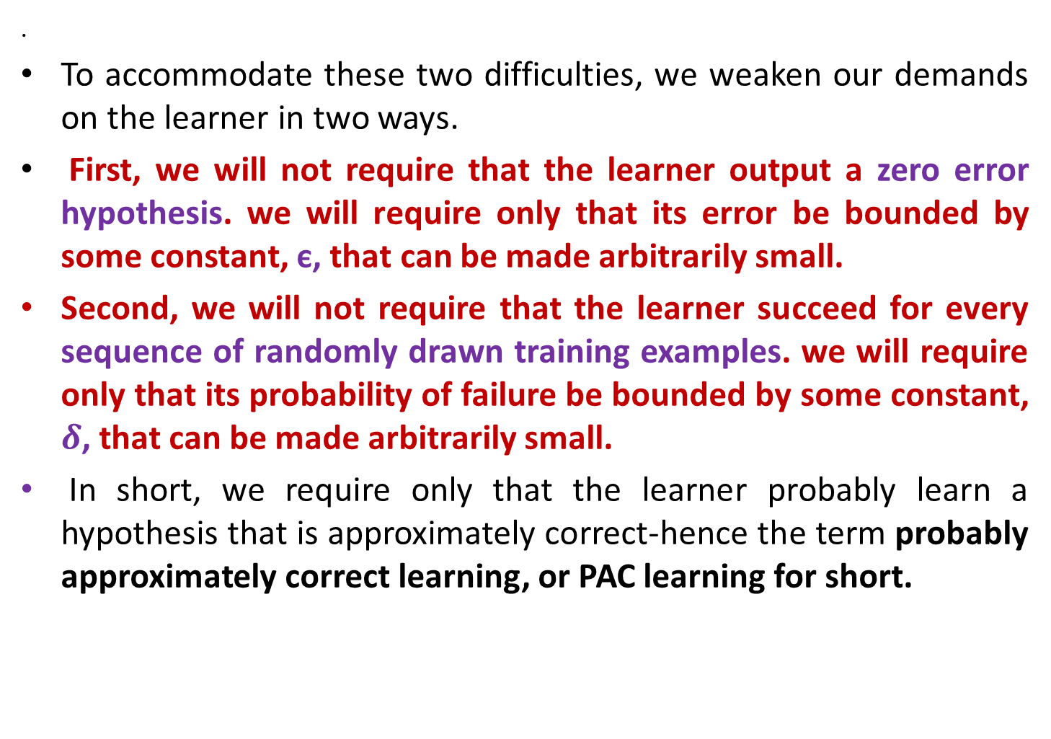
.
To accommodate these two difficulties, we weaken our demands on the learner in two ways.
First, we will not require that the learner output a zero error hypothesis. we will require only that its error be bounded by some constant, є, that can be made arbitrarily small.
Second, we will not require that the learner succeed for every sequence of randomly drawn training examples. we will require only that its probability of failure be bounded by some constant, $δ$, that can be made arbitrarily small.
In short, we require only that the learner probably learn a hypothesis that is approximately correct-hence the term probably approximately correct learning, or PAC learning for short.

Slide 14
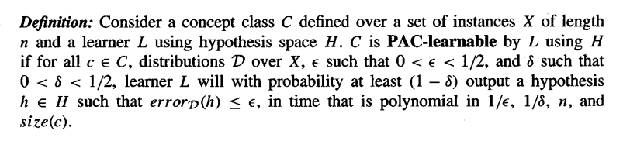
Consider some class C of possible target concepts and a learner L using hypothesis space H.
we will say that the concept class C is PAC-learnable by L using H if, for any target concept c in C, L will with probability (1 - δ) output a hypothesis h with errorD(h) < є, after observing a reasonable number of training examples and performing a reasonable amount of computation
Our definition requires two things from L. First, L must, with arbitrarily high probability (1 - δ), output a hypothesis having arbitrarily low error (є). Second, it must do so efficiently-in time that grows at most polynomially with 1/є and 1/δ which define the strength of our demands on the output hypothesis, and with n and size(c) that define the inherent complexity of the underlying instance space X and concept class C. Here, n is the size of instances in X.

Slide 15
SAMPLE COMPLEXITY FOR FINITE HYPOTHESIS SPACES
PAC-learnability is largely determined by the number of training examples required by the learner.
The growth in the number of required training examples with problem size, called the sample complexity of the learning problem
The reason is that in most practical settings the factor that limits success of the learner is the limited availability of training data.
Here we present a general bound on the sample complexity for a very broad class of learners, called consistent learners.
A learner is consistent if it outputs hypotheses that perfectly fit the training data, whenever possible.

Slide 16
SAMPLE COMPLEXITY FOR FINITE HYPOTHESIS SPACES
Can we derive a bound on the number of training examples required by any consistent learner, independent of the specific algorithm it uses to derive a consistent hypothesis? The answer is yes
The version space, VS_{H,D} to be the set of all hypotheses h є H that correctly classify the training examples D.

Slide 17
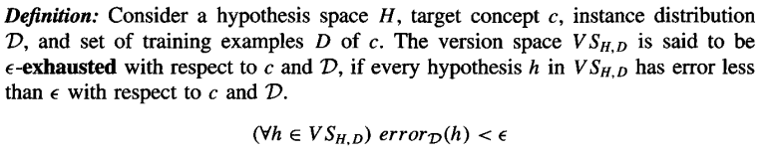
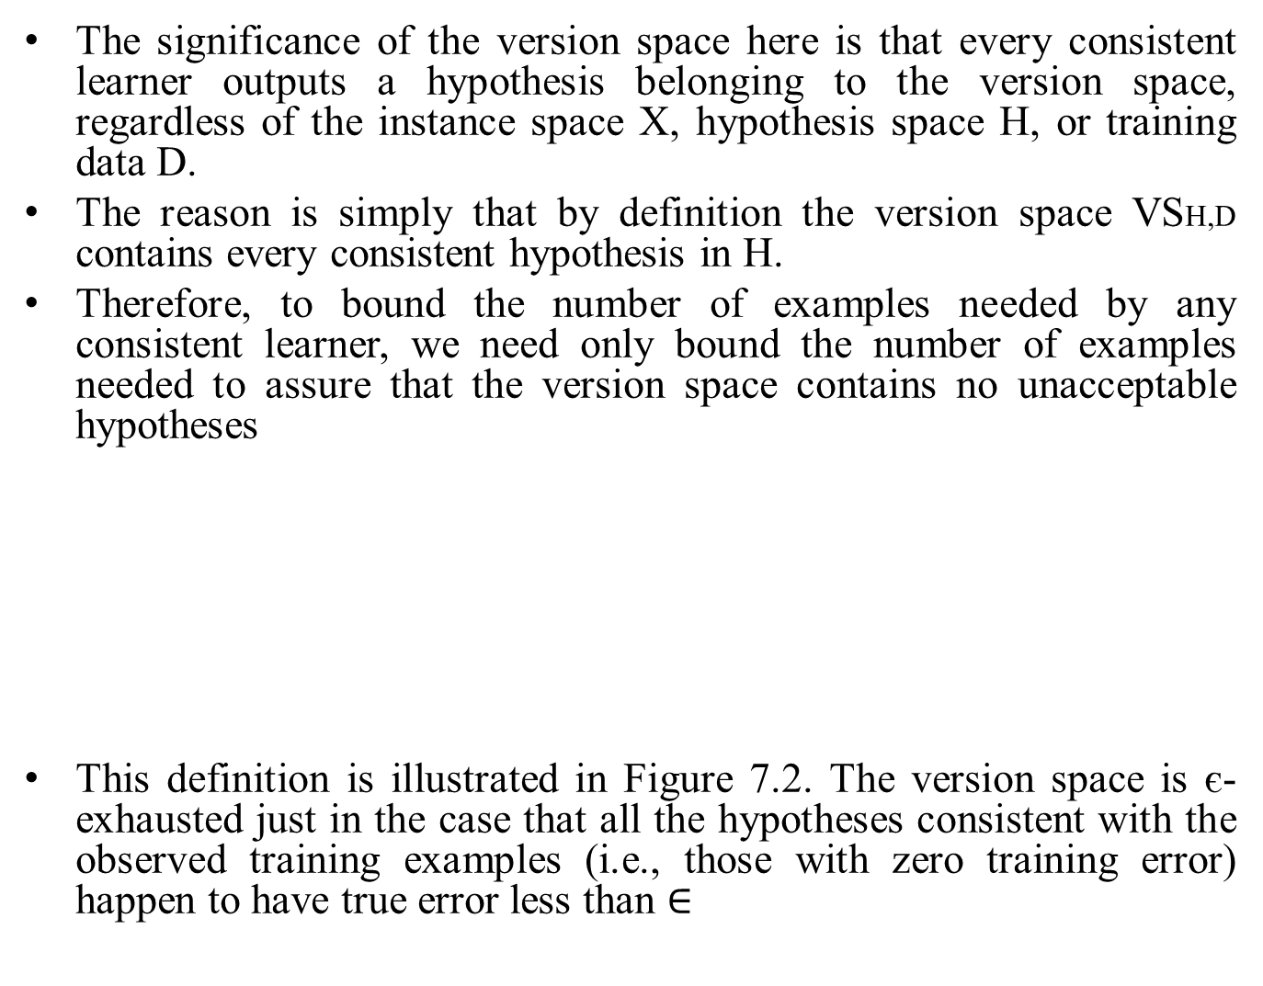
The significance of the version space here is that every consistent learner outputs a hypothesis belonging to the version space, regardless of the instance space X, hypothesis space H, or training data D.
The reason is simply that by definition the version space VSH,D contains every consistent hypothesis in H.
Therefore, to bound the number of examples needed by any consistent learner, we need only bound the number of examples needed to assure that the version space contains no unacceptable hypotheses
This definition is illustrated in Figure 7.2. The version space is є-exhausted just in the case that all the hypotheses consistent with the observed training examples (i.e., those with zero training error) happen to have true error less than $∈$

Slide 18
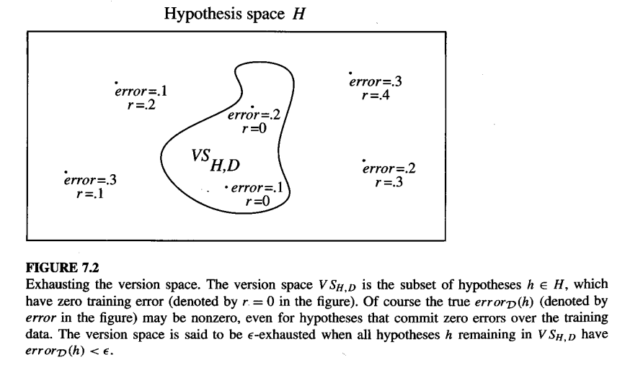

Slide 19
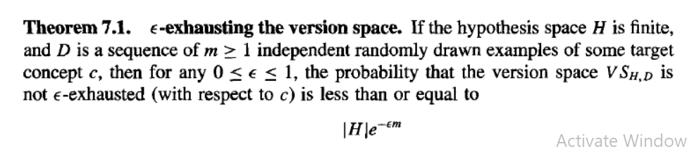

Slide 20
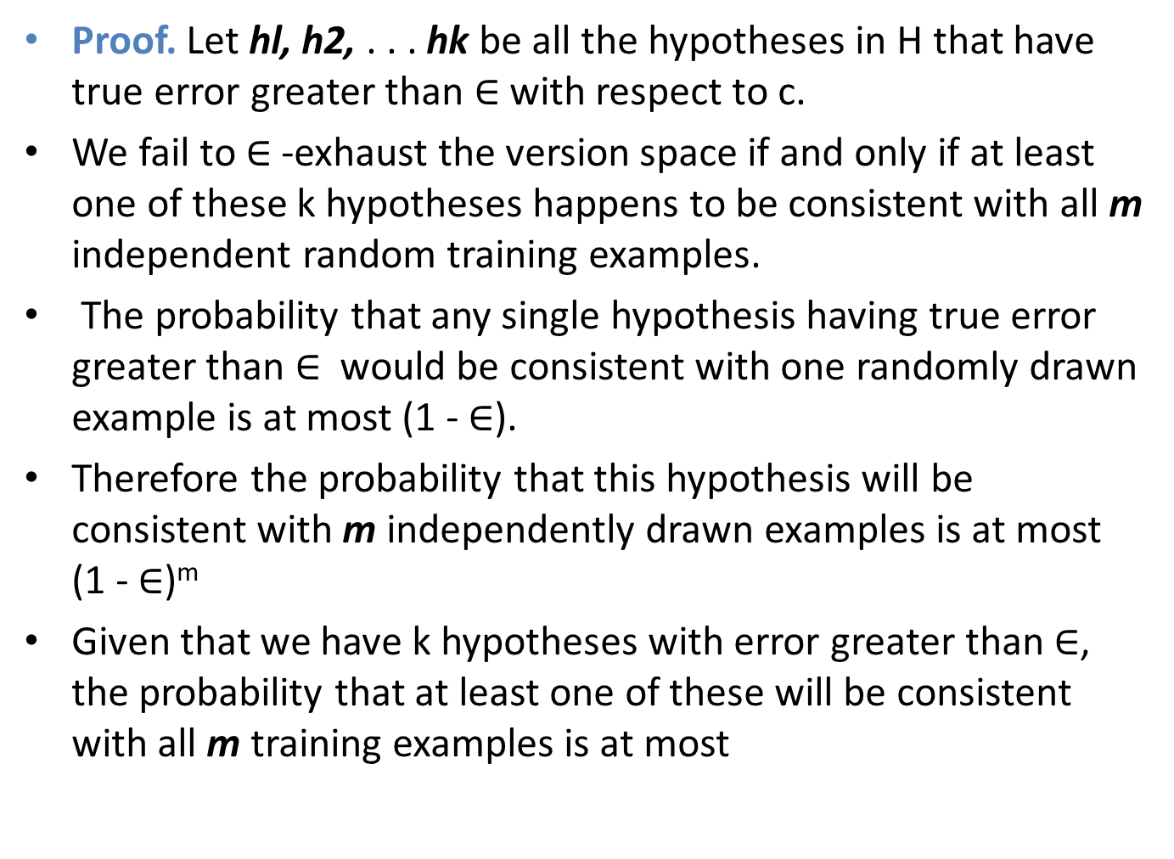
Proof. Let hl, h2, . . . hk be all the hypotheses in H that have true error greater than $∈$with respect to c.
We fail to $∈$-exhaust the version space if and only if at least one of these k hypotheses happens to be consistent with all m independent random training examples.
The probability that any single hypothesis having true error greater than $∈$ would be consistent with one randomly drawn example is at most (1 - $∈$).
Therefore the probability that this hypothesis will be consistent with m independently drawn examples is at most (1 - $∈$)^{m}
Given that we have k hypotheses with error greater than $∈$, the probability that at least one of these will be consistent with all m training examples is at most

Slide 21
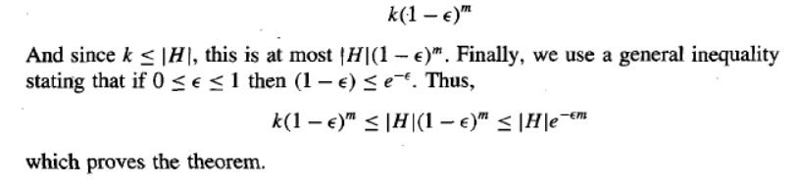
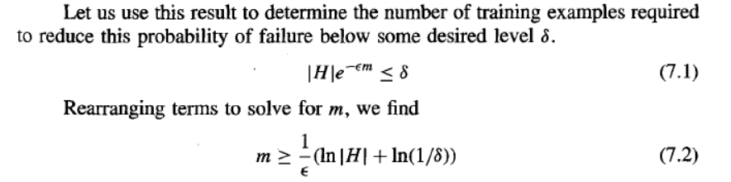

Slide 22
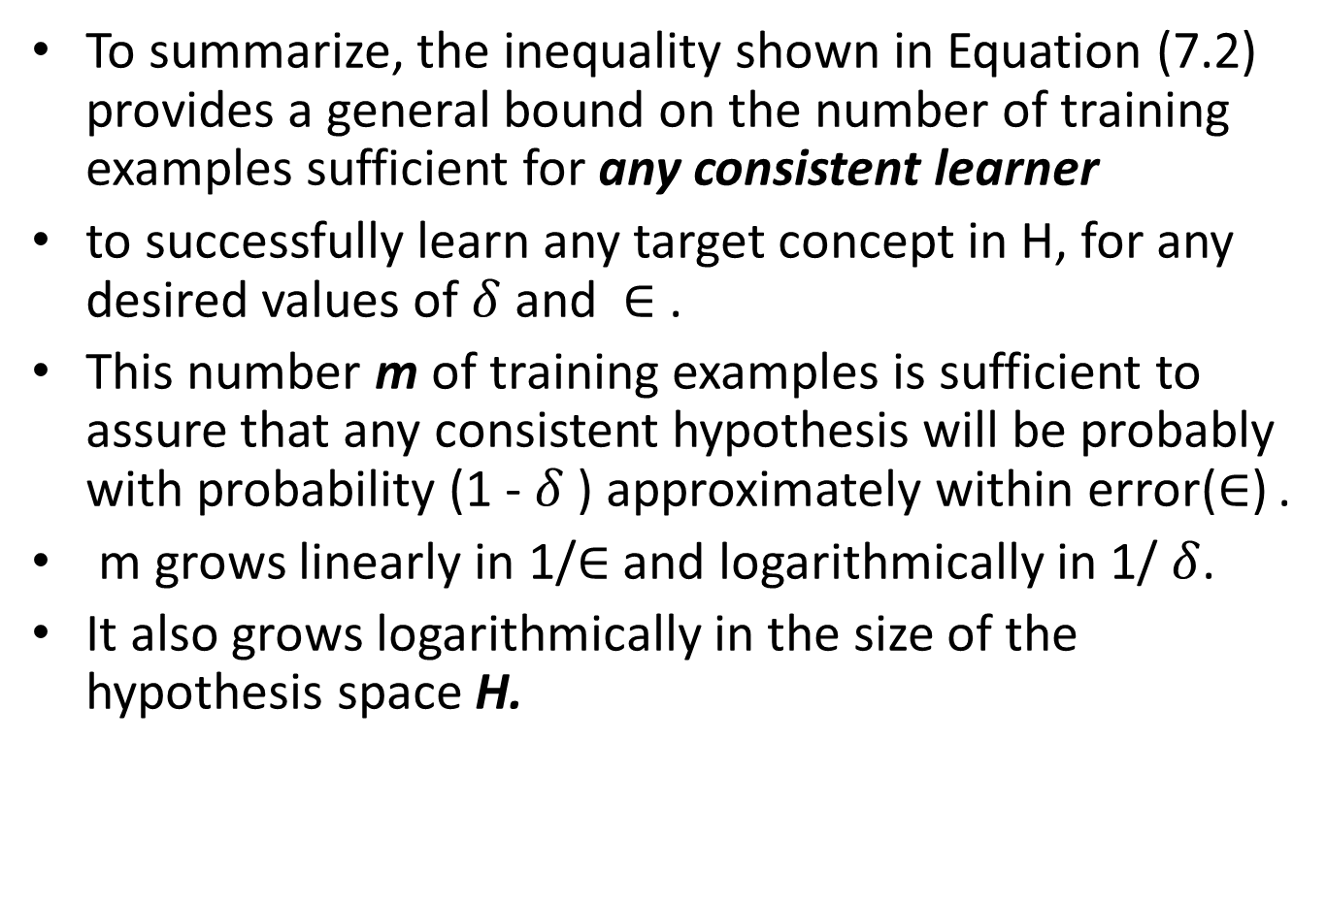
To summarize, the inequality shown in Equation (7.2) provides a general bound on the number of training examples sufficient for any consistent learner
to successfully learn any target concept in H, for any desired values of $δ$ and $∈$ .
This number m of training examples is sufficient to assure that any consistent hypothesis will be probably with probability (1 - $δ$ ) approximately within error($∈$) .
m grows linearly in 1/$∈$ and logarithmically in 1/ $δ$.
It also grows logarithmically in the size of the hypothesis space H.

Slide 23
SAMPLE COMPLEXITY FOR INFINITE HYPOTHESIS SPACES
We showed that sample complexity for PAC learning grows as the logarithm of the size of the hypothesis space.
While Equation (7.2) is quite useful, there are two drawbacks to characterizing sample complexity in terms of |H|.
First, it can lead to quite weak bounds (bound on δ can be significantly greater than 1 for large |H|).
Second, in the case of infinite hypothesis spaces we cannot apply Equation (7.2) at all!
Here we consider a second measure of the complexity of H, called the Vapnik-Chervonenkis dimension VC(H).
As we shall see, we can state bounds on sample complexity that use VC(H) rather than |H|. In many cases, the sample complexity bounds based on VC(H) will be tighter than those from Equation (7.2)

Slide 24
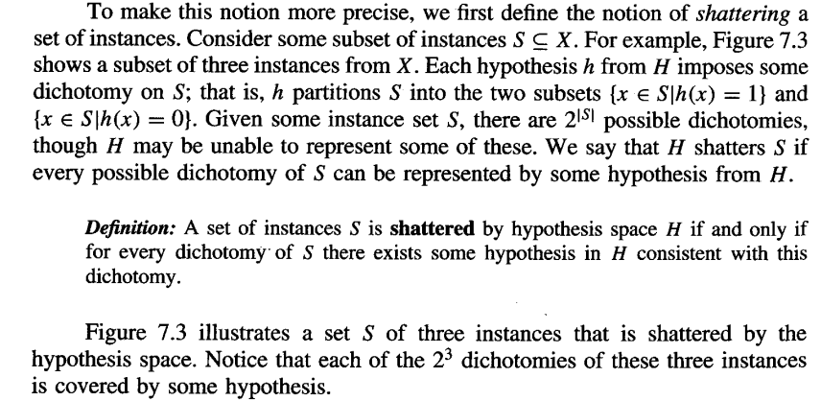
Shattering a Set of Instances
The VC dimension measures the complexity of the hypothesis space H, not by the number of distinct hypotheses |H|, but instead by the number of distinct instances from X that can be completely discriminated using H.

Slide 25
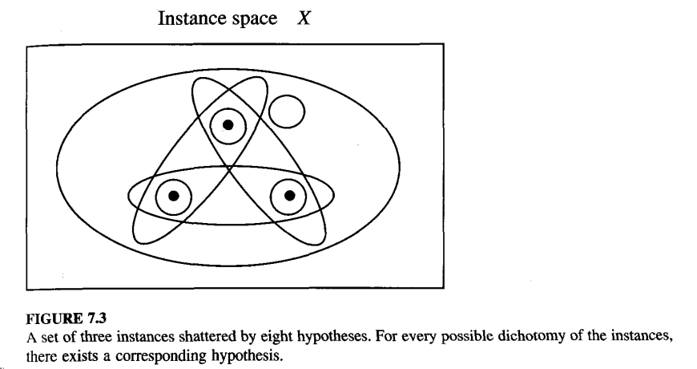

Slide 26
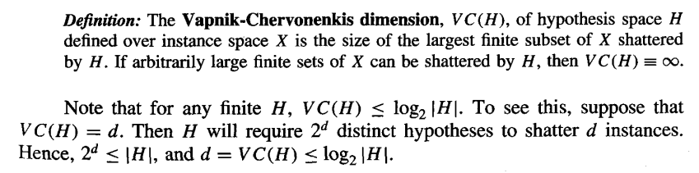
The Vapnik-Chervonenkis Dimension
hypothesis space H is one that shatters the instance space X. What if H cannot shatter X, but can shatter some large subset S of X? The larger the subset of X that can be shattered, the more expressive H. The VC dimension of H is precisely this measure.

Slide 27
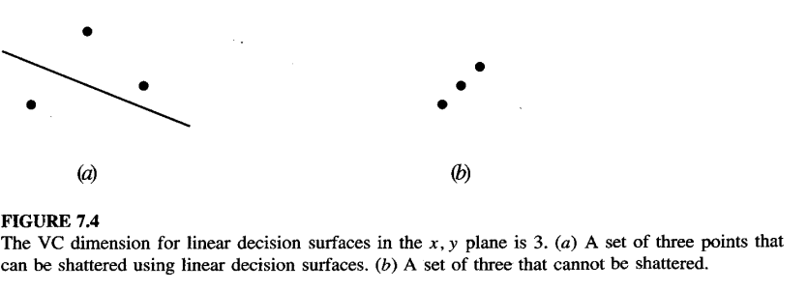
ILLUSTRATIVE EXAMPLES
In order to develop an intuitive feeling for VC(H), consider a few example hypothesis spaces.
To get started, suppose the instance space X is the set of real numbers X = R (e.g., describing the height of people), and H the set of intervals on the real number line.
H is the set of hypotheses of the form a < x < b, where a and b may be any real constants.
What is VC(H)? To answer this question, we must find the largest subset of X that can be shattered by H.
Consider a particular subset containing two distinct instances, say S = {3.1,5.7}.
Can S be shattered by H? Yes. For example, the four hypotheses (1 < x < 2), (1 < x < 4), (4 < x < 7), and (1 < x < 7) will do.

Slide 28
Together, they represent each of the four dichotomies over S, covering neither instance, either one of the instances, and both of the instances, respectively.
Since we have found a set of size two that can be shattered by H, we know the VC dimension of H is at least two.
Is there a set of size three that can be shattered?
Consider a set S = (xo, xl, x2} containing three arbitrary instances.
assume xo < xl < x2. Clearly this set cannot be shattered, because the dichotomy that includes xo and x2, but not XI, cannot be represented by a single closed interval.
Therefore, no subset S of size three can be shattered, and VC(H) = 2.

Slide 29
Next consider the set X of instances corresponding to points on the x, y plane
(see Figure 7.4). Let H be the set of all linear decision surfaces in the plane.
It is easy to see that any two distinct points in the plane can be shattered by H, because we can find four linear surfaces that include neither, either, or both points.
What about sets of three points?
As long as the points are not colinear, we will be able to find 2³ linear surfaces that shatter them.
Of course three colinear points cannot be shattered
for the same reason that the three points on the real line could not be shattered in the previous example.

Slide 30
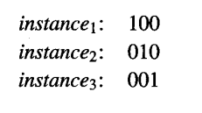
Example: suppose each instance in X is described by the conjunction of exactly three boolean literals, and suppose that each hypothesis in H is described by the conjunction of up to three boolean literals. What is VC(H)? We can show that it is at least 3, as follows.
Represent each instance by a 3-bit string corresponding to the values of each of its three literals l1, l2, and l3. Consider the following set of three instances:
This set of three instances can be shattered by H, because a hypothesis can be constructed for any desired dichotomy as follows: If the dichotomy is to exclude instance_{i} add the literal ¬l_{i} to the hypothesis.

Slide 31

For example, suppose we
wish to include instance2, but exclude instance1 and instance3. Then we use the
hypothesis
¬l₁ ¬l₃

Slide 32
Note that the above bound can be a substantial overestimate. For example,
although the probability of failing to exhaust the version space must lie in the
interval [O, 11, the bound given by the theorem grows linearly with IHI. For
sufficiently large hypothesis spaces, this bound can easily be greater than one.
As a result, the bound given by the inequality in Equation (7.2) can substantially
overestimate the number of training examples required. The weakness of this
bound is mainly due to the IHI term, which arises in the proof when summing
the probability that a single hypothesis could be unacceptable, over all possible
hypotheses. In fact, a much tighter bound is possible in many cases, as well as a
bound that covers infinitely large hypothesis spaces. This will be the subject of
Section 7.4.
7.3.1 Agnostic Learning

